Slide 1
Computer Architecture
Lab 7

Slide 2
MIPS Instruction Set Architecture

Slide 3
Memory in MIPS
Memory
100 | 8 bits
101 | 8 bits
102 | 8 bits
103 | 8 bits
104 | 8 bits
105 | 8 bits
Instruction / Data
To store any value in the memory you need 4 cells

Slide 4
Save Value in the Memory
Memory
100 | 5
101 | 8 bits
102 | 8 bits
103 | 8 bits
104
105
106
107
Num1: .word 5
Num1
The starting address of the memory cells where the data will be saved which is 100

Slide 5
Read Value from the Memory
Memory
la $s0, Num1
Load the address Num1 and save it in register s0
100 | 5
101 | 8 bits
102 | 8 bits
103 | 8 bits
104
105
106
107
Num1
Contains Address 100
lw $s1, 0($s0)
Load the data from the address in s0 + 3 more cells and save it in register s1
Contains
Address=100
Contains
Data=5

Slide 6
Store Value back in the Memory
Memory
Num2: .word 0
li $S4, 6
100 | 5
101 | 8 bits
102 | 8 bits
103 | 8 bits
104 | 0
105
106
107
Num1
la $s1, Num2
sw $s4, 0($s1)
Num2
Contains the starting Address where the data will be saved

Slide 7
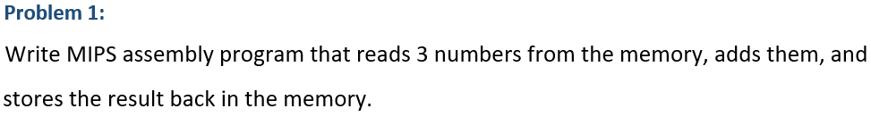
.globl main
.data
Num1: .word 5
Num2: .word 3
Num3: .word 2
RES: .word 0
.text
main:
la $t1, Num1
la $t2, Num2
la $t3, Num3
la $t4, RES
lw $s1, 0($t1)
lw $s2, 0($t2)
lw $s3, 0($t3)
add $t5, $s1, $s2
add $s4, $t5, $s3
sw $s4, 0($t4)
li $v0,10
syscall

Slide 8
.globl main
.data
Num1: .word 5
Num2: .word 3
Num3: .word 2
RES: .word 0
.text
main:
la $t1, Num1
lw $s1, 0($t1)
addi $t1,4
lw $s2, 0($t1)
addi $t1,4
lw $s3, 0($t1)
add $t5, $s1, $s2
add $s4, $t5, $s3
addi $t1,4
sw $s4, 0($t1)
li $v0,10
syscall

Slide 9
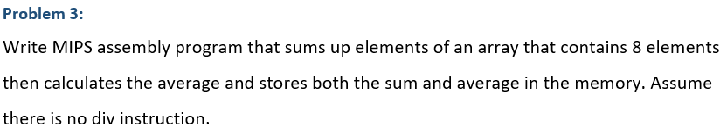
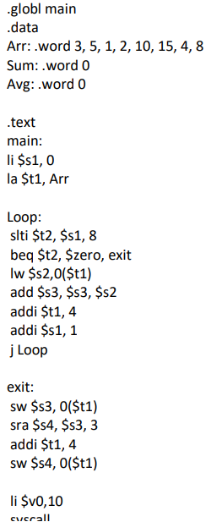
Counter for the 8 elements
Loop over the 8 elements
Read the data from the memory
Increment the address
Increment the loop counter
Store the sum
Store the avg

Slide 10
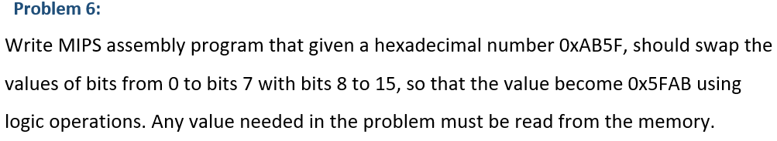
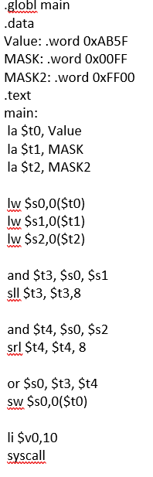
AB5F
AB 5F
FF 00 and
----------------------
AB 00
AB 5F
00 FF and
----------------------
00 5F
AB00
005F
Logical Shift Right
Logical Shift Left
00AB
5F00
or
5FAB

